Slide 1


Slide 2





Company Introduction
Triple P accounting firm is a burgeoning company dedicated to providing professional, reliable, and comprehensive accounting solutions. Our mission is to assist individuals, small and medium-sized enterprises, and entrepreneurs in managing their finances, allowing them to focus on business development with confidence in entrusting their financial work to us, we have the capability to offer tailored accounting and financial services to meet your unique needs.
know more about us

Slide 3








Our Team
These three founders are dedicated to providing excellent accounting and financial services.
Pirk
Picard
Paneway
Years of experience in accounting and financial management.
An expert in tax regulations and strategies.
Known for innovation and a focus on financial efficiency.
FOLLOW US !
3

Slide 4






Enterprise Culture
Our Mission
Our Purpose
Our Guideline
Our Vision
Our mission is to provide exceptional accounting services to small businesses and empower their financial success through perfect tax accounting support.
Our purpose is to simplify financial management for small businesses by providing them with clear and practical solutions.
Our guideline is to prioritize interests of clients and uphold the values of integrity, precision, and efficiency.
Our vision is to create lasting value for our clients through outstanding service and innovative solutions.
4

Slide 5





Future Development Timeline
Develop
Growth and consolidation
Leading
Innovation and sustainable
2
4
1
3
Start
Establishing a foundation
Accelerate
Expansion and absorption
5

Slide 6


Slide 7



Slide 8



Slide 9



Slide 10


Slide 11
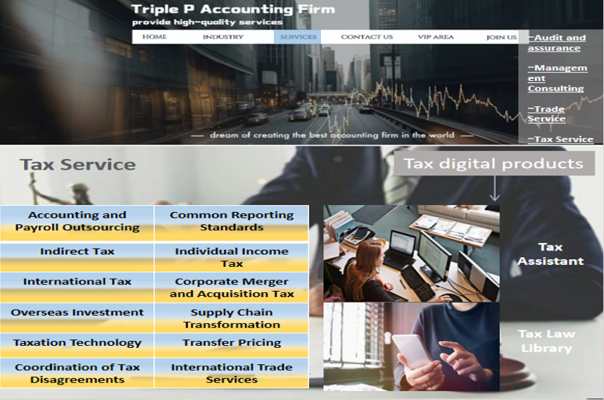

Slide 12
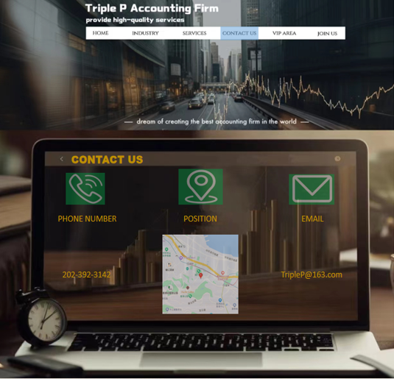

Slide 13


Slide 14


